Slide 1


Oasis: An Online Marketplace
Amirali Sajadi
Dhrumil Patel
Shashwat Mann

Slide 2
What is Oasis?
Oasis is an online e-commerce company that brokers C2C and retail sales through online marketplaces. Oasis will be used by individuals and companies. Buyers can review sellers and their products after a transaction, resulting in a reputation system.

Slide 3
Features
Buy products
Sell Products
Cart for users who are considering buying a product
Wishlist for the ones who are too broke to add them in their cart
Password Encryption

Slide 4
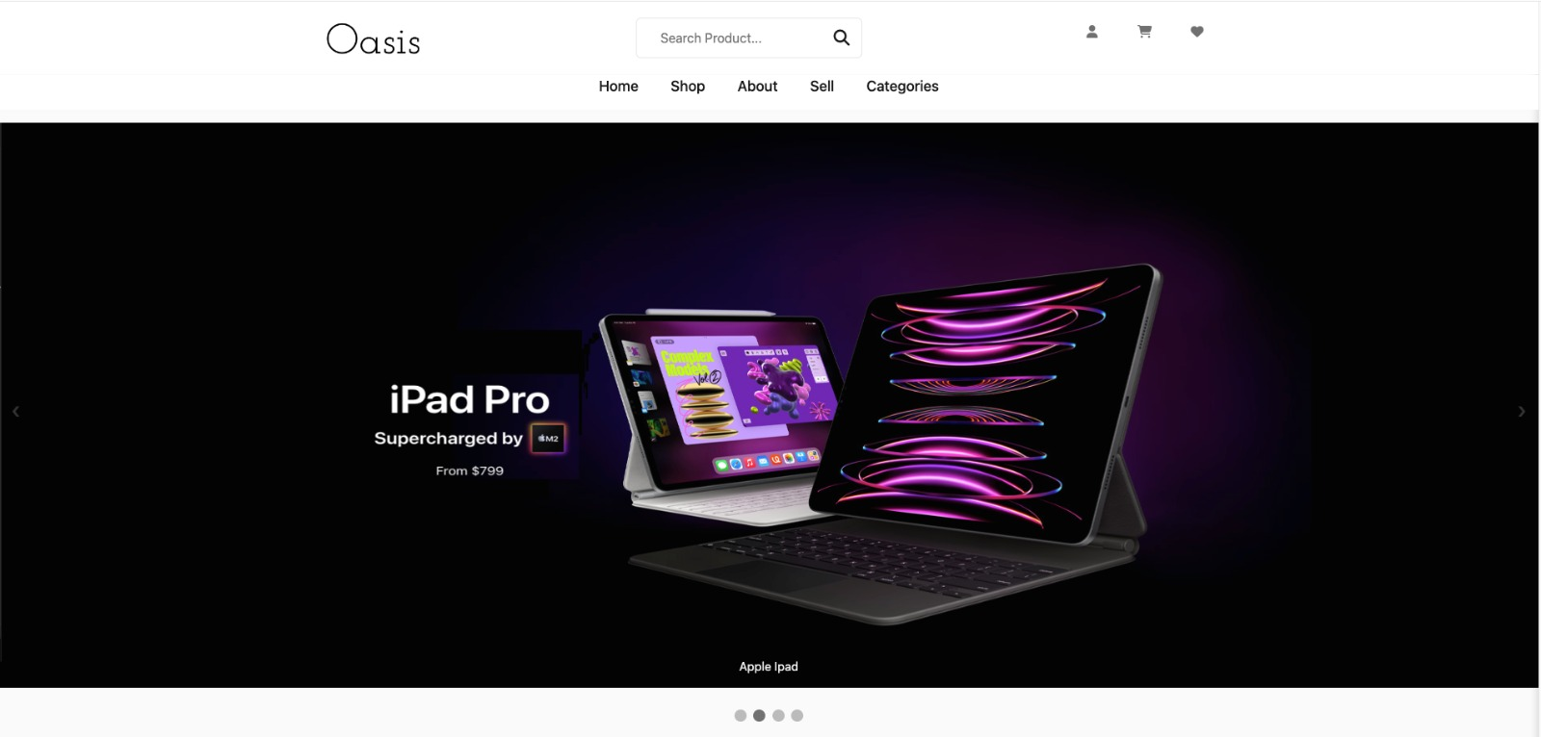
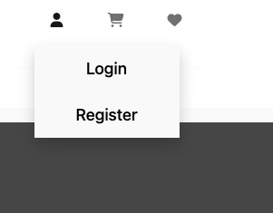
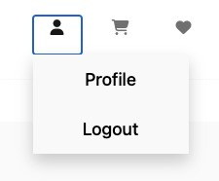
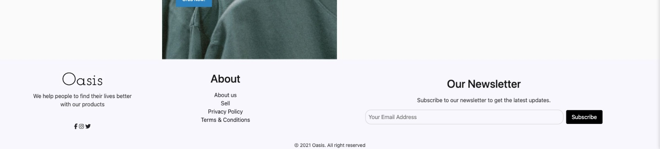

Slide 5
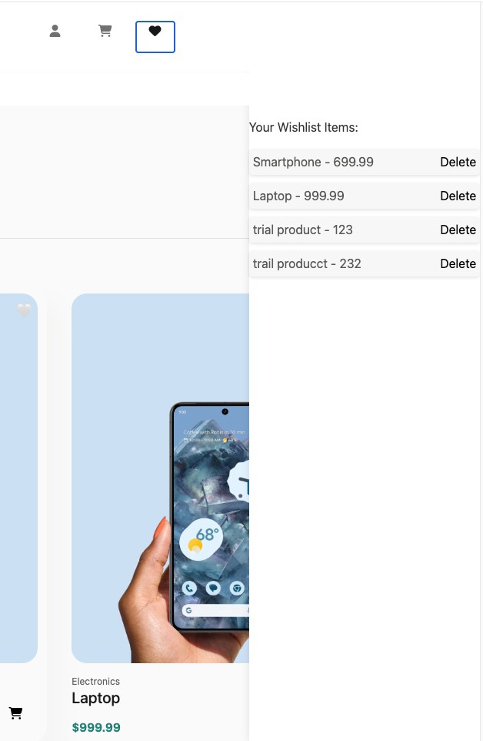
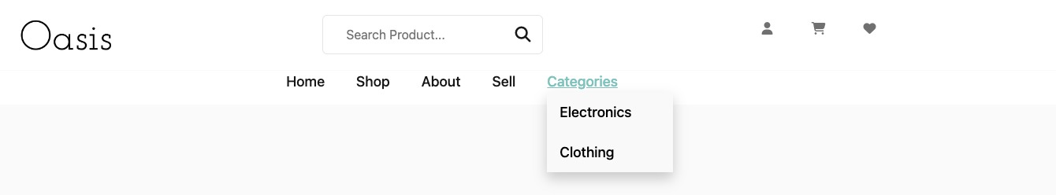
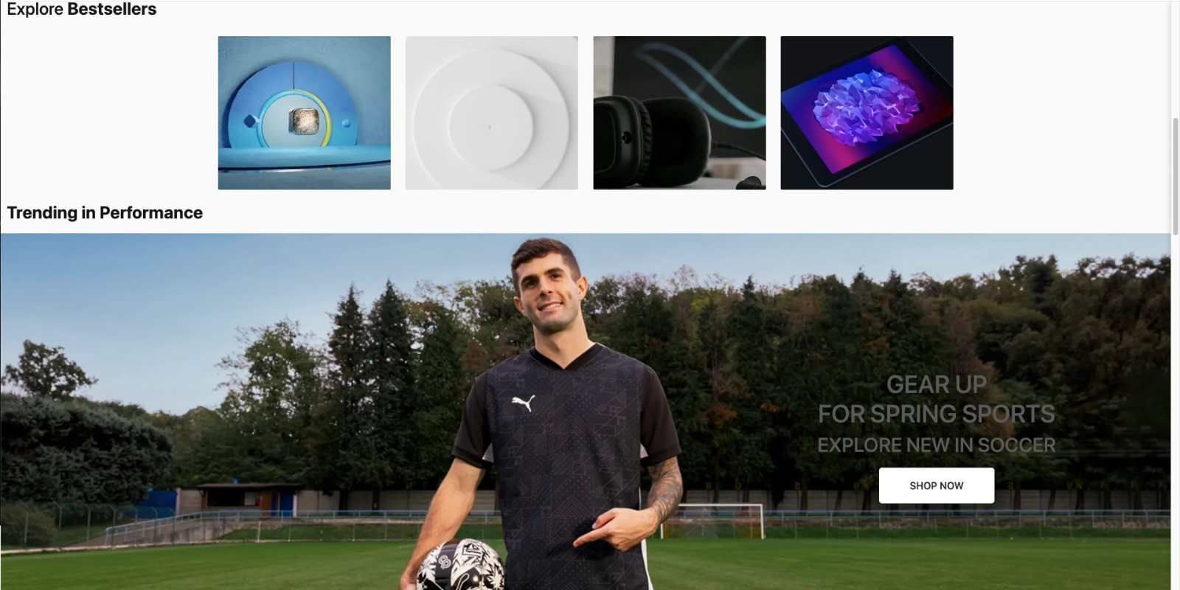

Slide 6
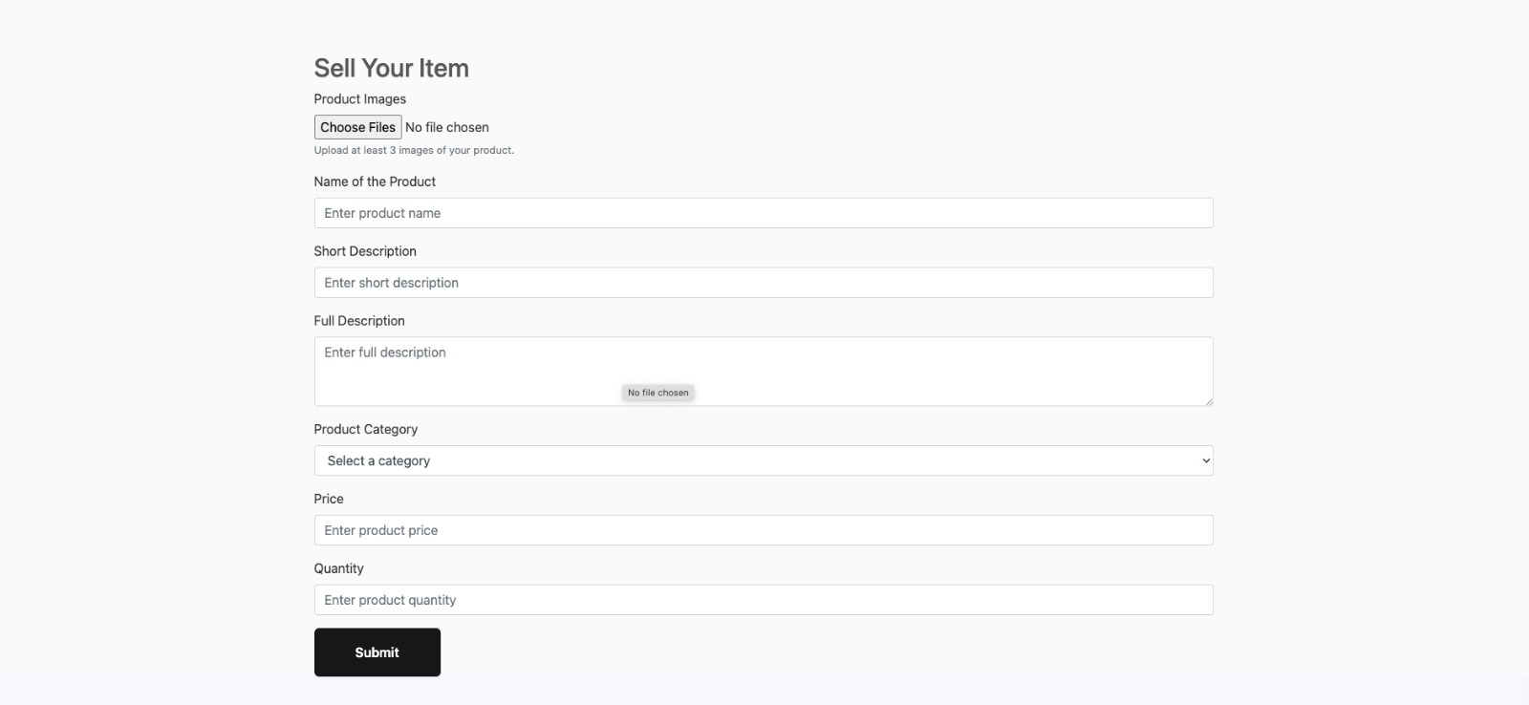

Slide 7
Demo

